Slide 1

VIRAT Video and Interaction Relay Associated Tool

Slide 2
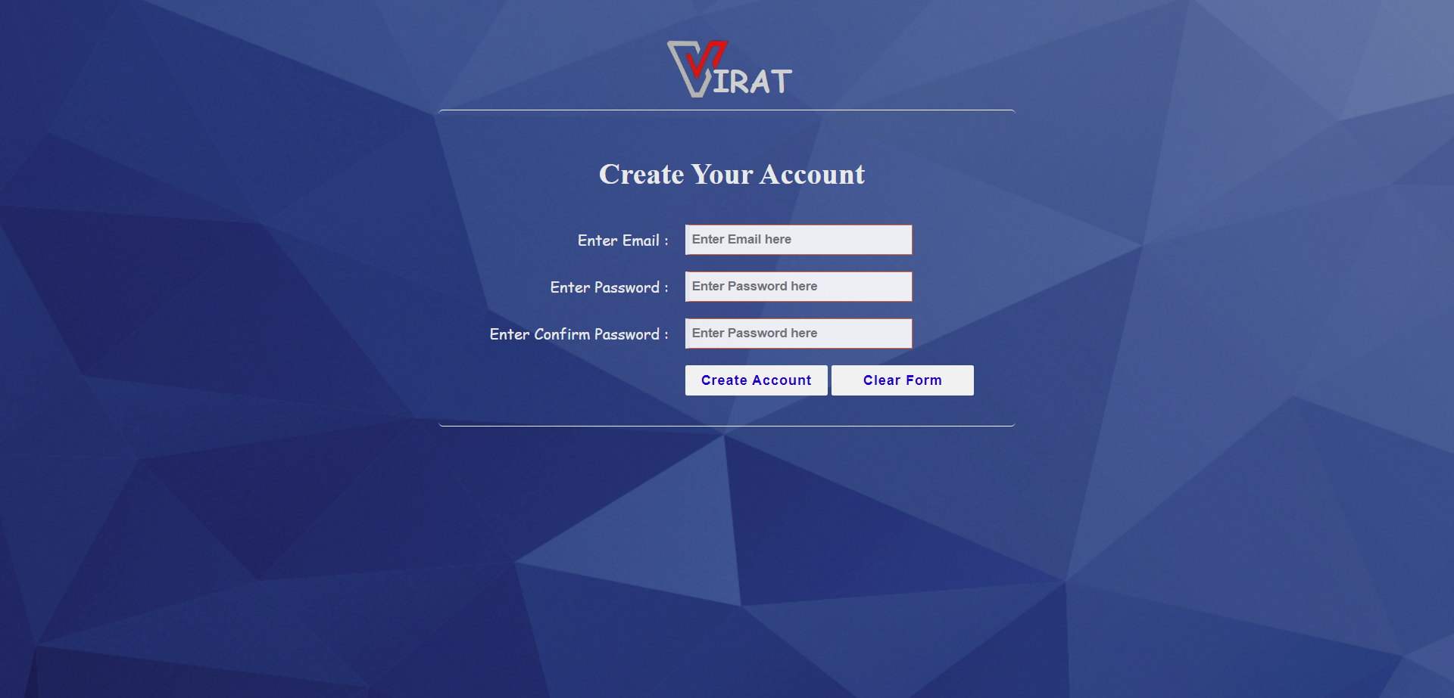
Signup Page

Slide 3
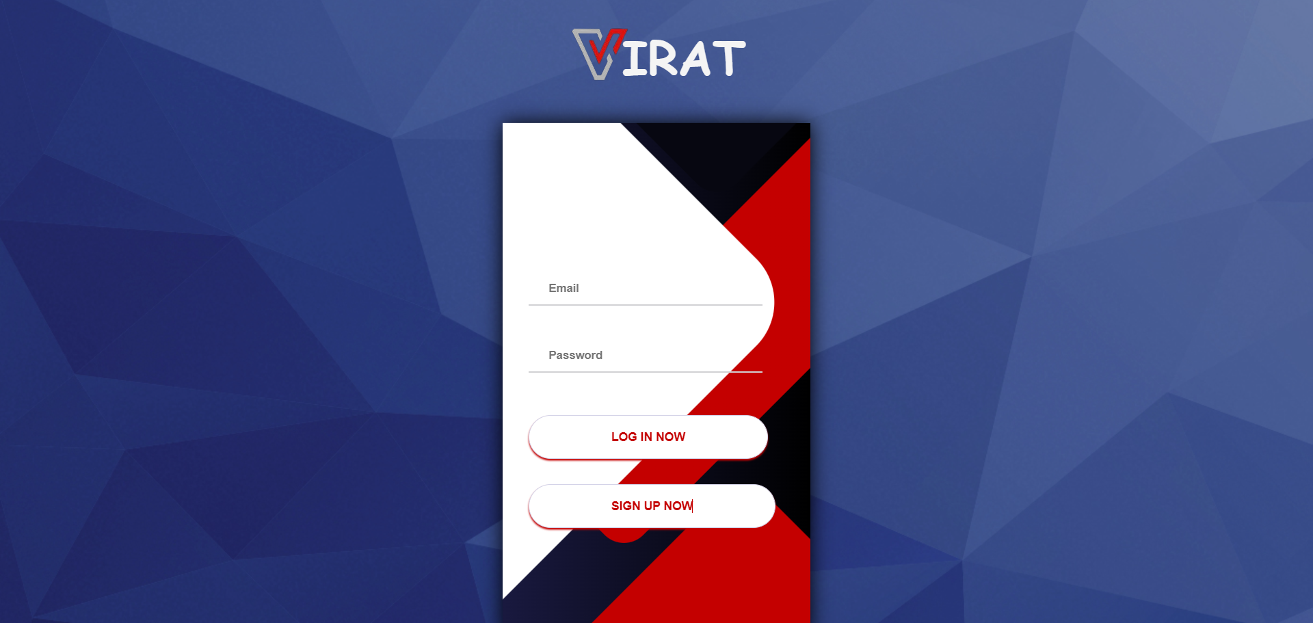
login Page

Slide 4
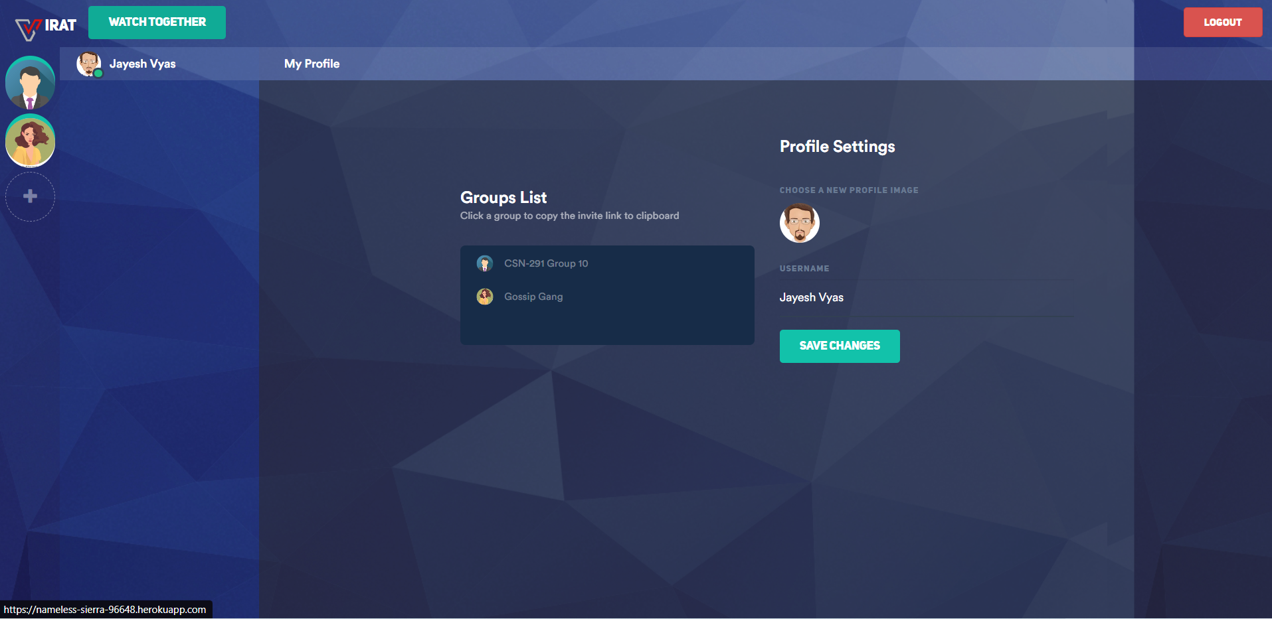
Dashboard

Slide 5
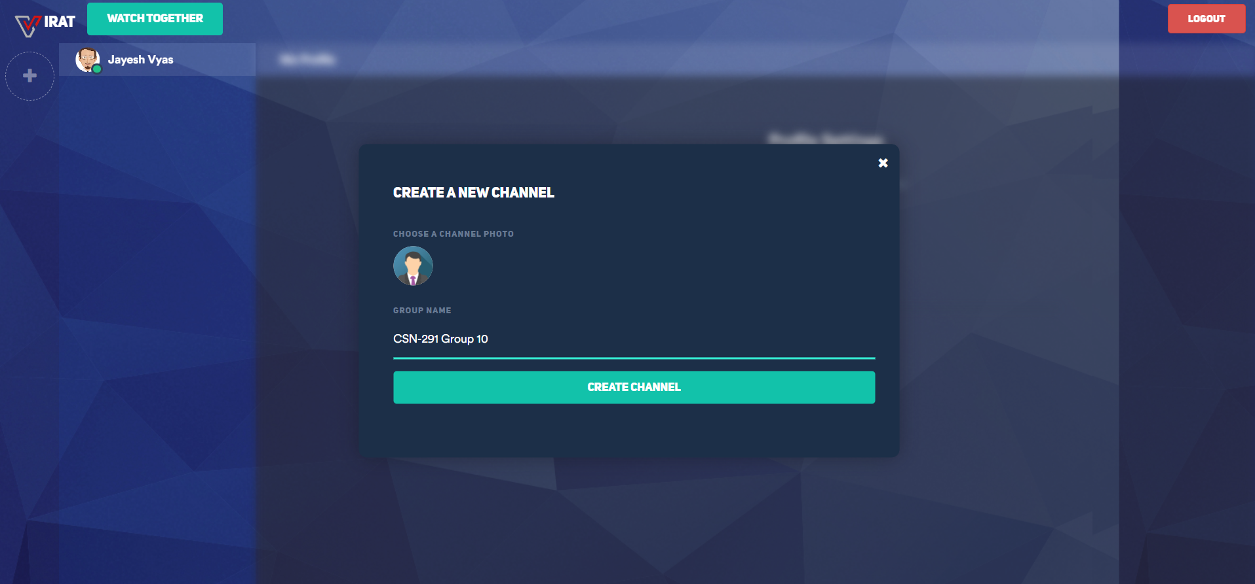
Create a new group

Slide 6
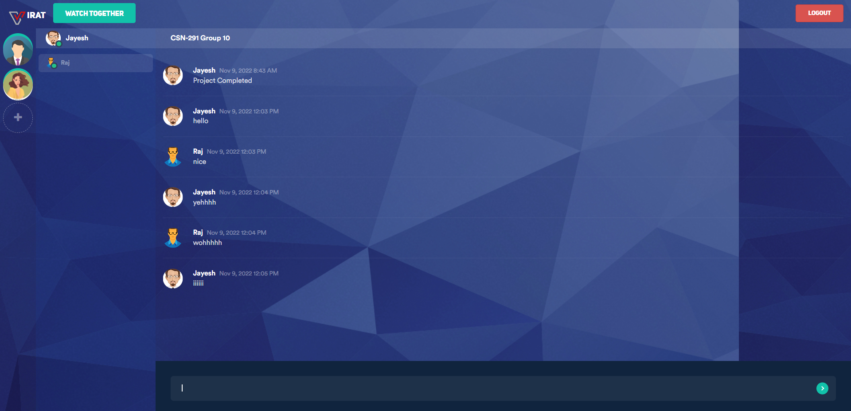
Chatting in a group

Slide 7
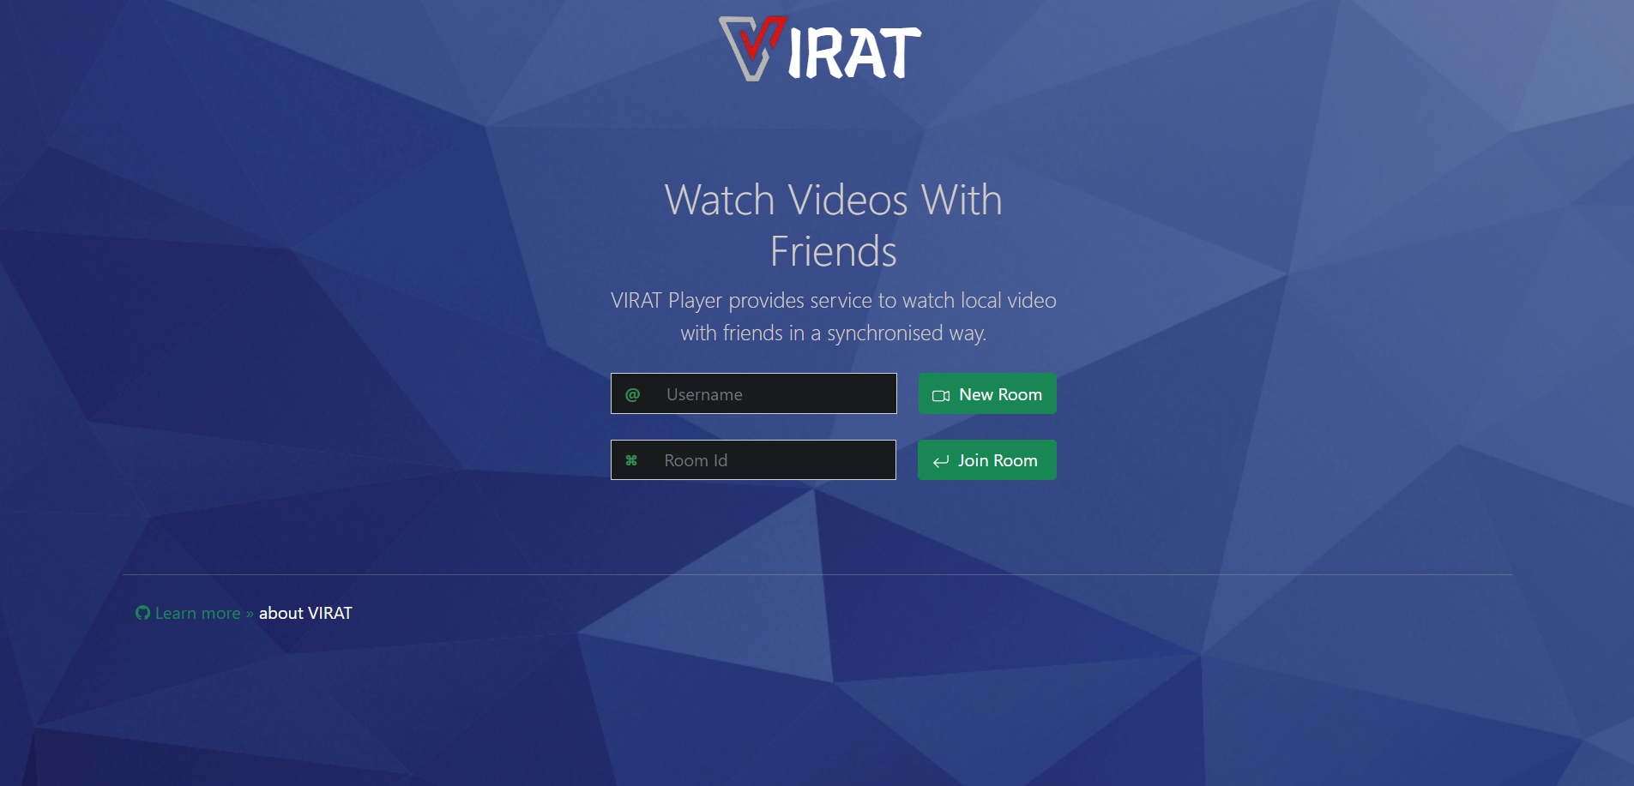
Watch Party Login

Slide 8
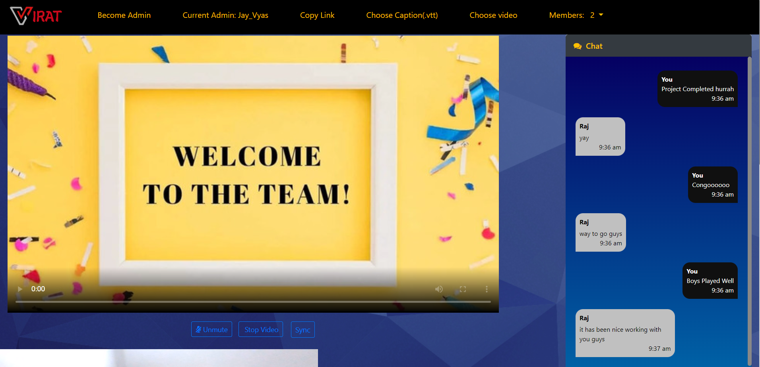
Watch Party

Slide 9
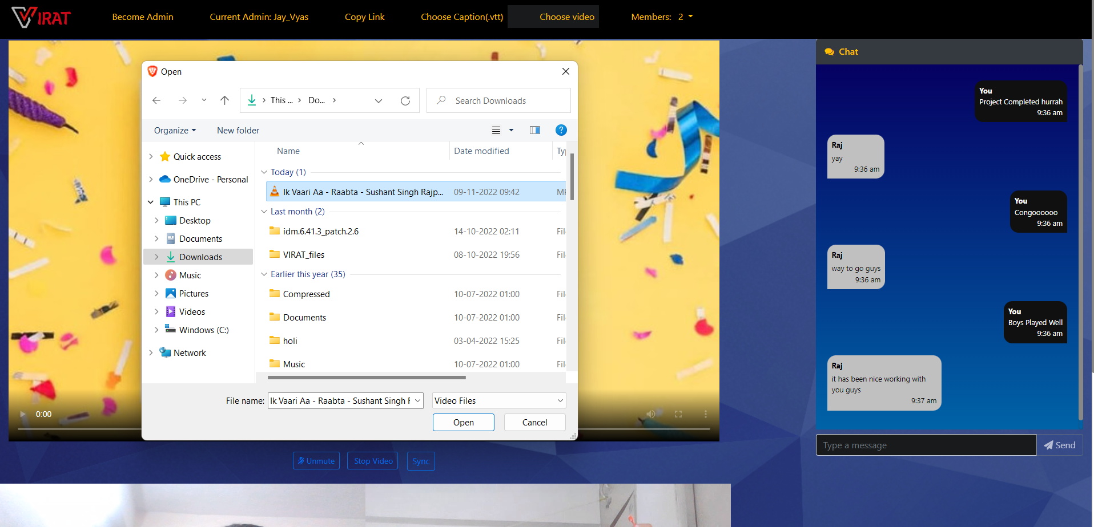
Selecting video to watch together

Slide 10
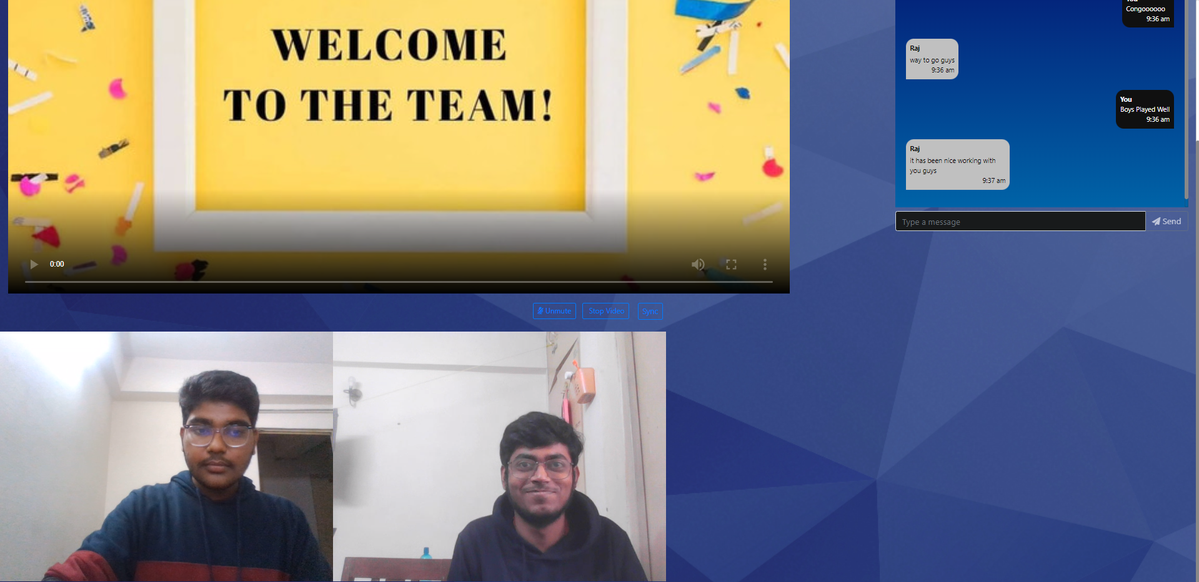
Video call in Watch Party

